Slide 1
GSK - DIGDATA ONLINE STEP-UP CAREER CHALLENGE PATH A: HELPING THE TEAM WITH DATA ANALYSIS
Marcos Fabietti
ignaf93@gmail.com

Slide 2
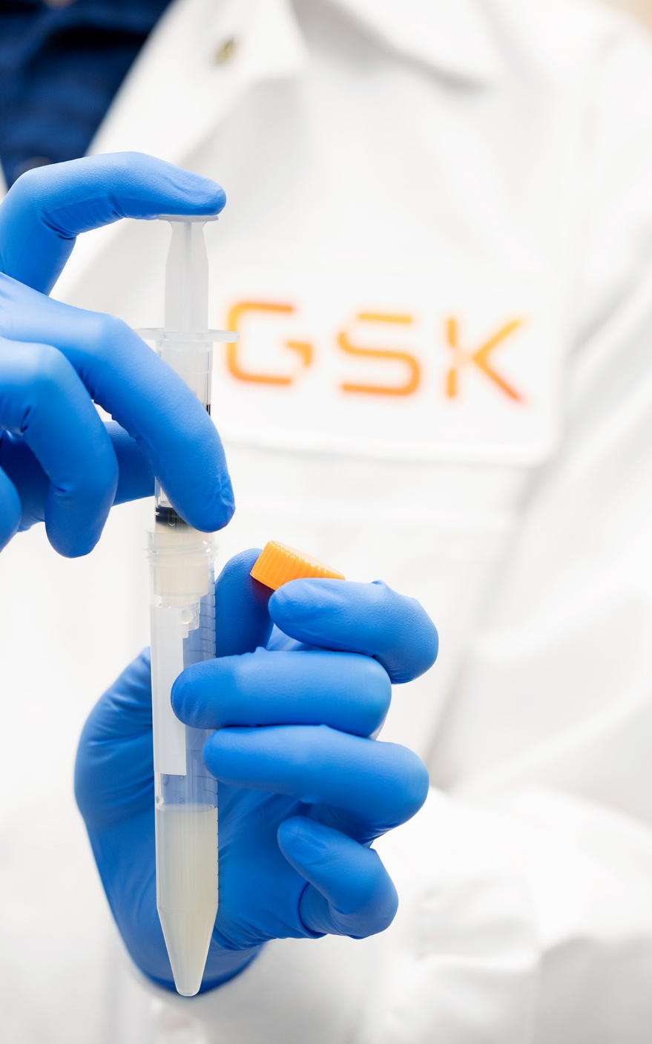
The Problem
A new cancer treatment for solid tumours (Miraculon-B) is in development at GSK, data has been collected in our recent clinical trial comparing Miraculon-B to the current standard of care (i.e., referred to as the ‘control’).
The trial has completed, and we need to analyse the data and assess the effectiveness of Miraculon-B. We need to compare Miraculon-B to the standard of care, and explore how different patient sub-groups may benefit differently from treatment.

Slide 3
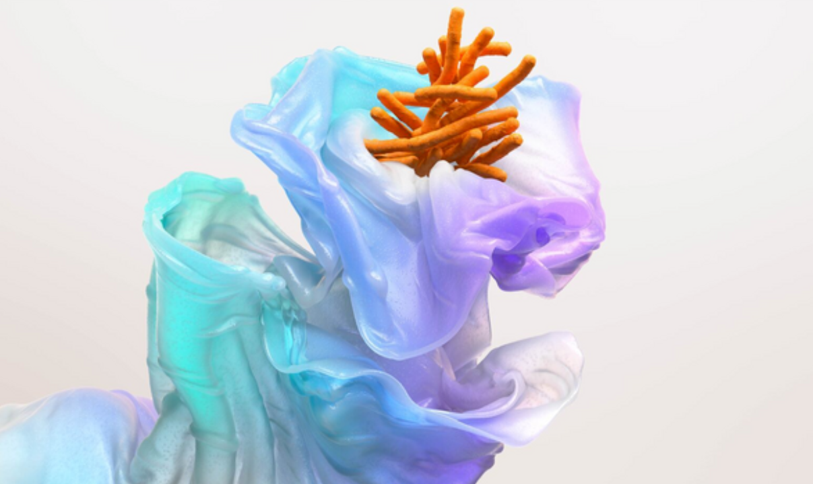
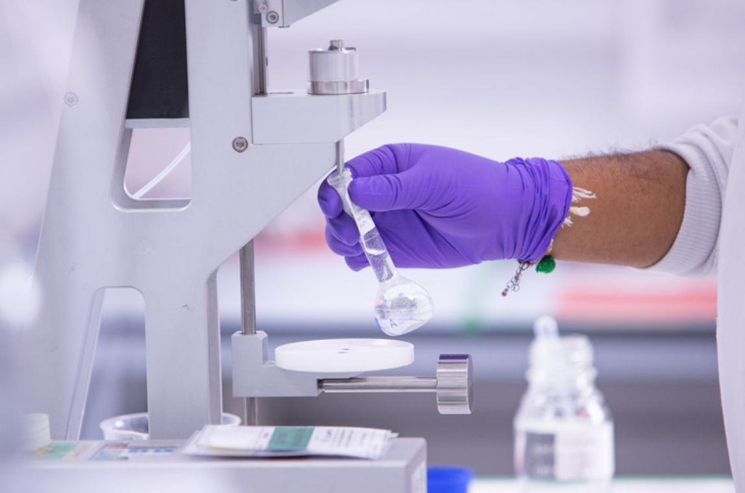
Questions
Do patients that take the GSK drug respond more to treatment compared to those in the control group?
Can the age, weight or protein concentration of patients predict whether they will respond better to treatment or not?

Slide 4
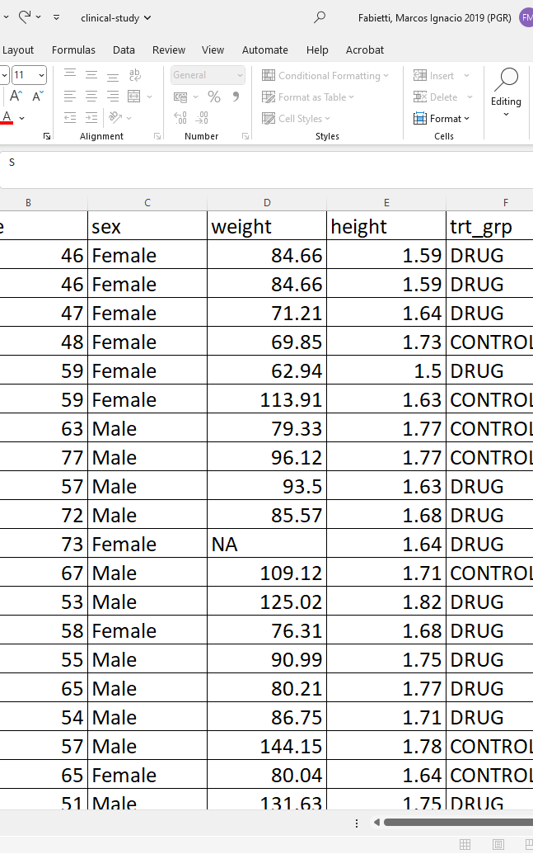
Data Description
GSK has shared 2 datasets, clinical-study.csv and protein-levels.csv
The dataset clinical-study.csv contains 772 rows (patients) and 7 columns (variables). The “response” column is our target showing whether the patient has responded to treatment (“Yes”) or not (“No”).
The dataset protein-levels.csv contains 768 rows and 2 columns, The protein_concentration column shows the concentration of a protein that has been identified as a potential predictive biomarker for solid tumours.
We want to investigate whether the concentration of the protein could predict whether the patient will respond or not to treatment.

Slide 5





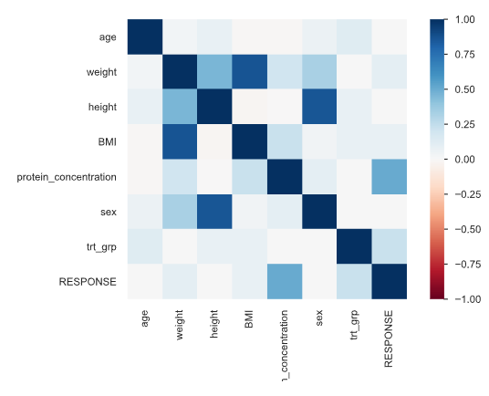
Exploratory Data Analysis
TOOLS
Duplicates removed
Missing values (weight, protein concentration) imputed with mean of group (gender)
Outliers (underage) removed
Datasets merged via the ID column
Created BMI variable
Correlation Matrix
High correlation between response variable and protein concentration

Slide 6
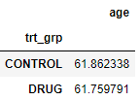
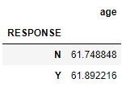
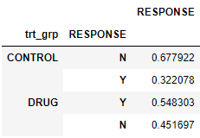
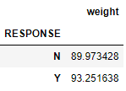
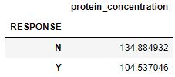
Aggregation Insights
a. Compare mean age in two treatment groups
b. Compare mean age
in responders vs non-responders
c. Compare responders and non-responders
in the two treatment arms
d. Compare mean weight
in responders/non-responders etc
e. Compare protein concentration
in responders vs non responders
Notes:
Our product areas | GSK

Slide 7
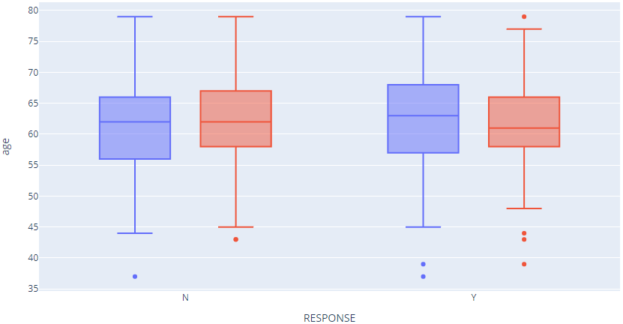
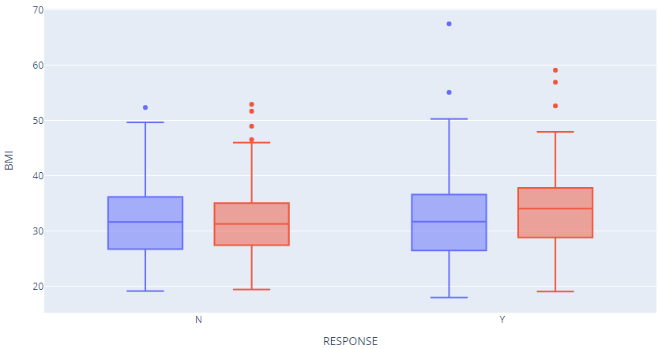
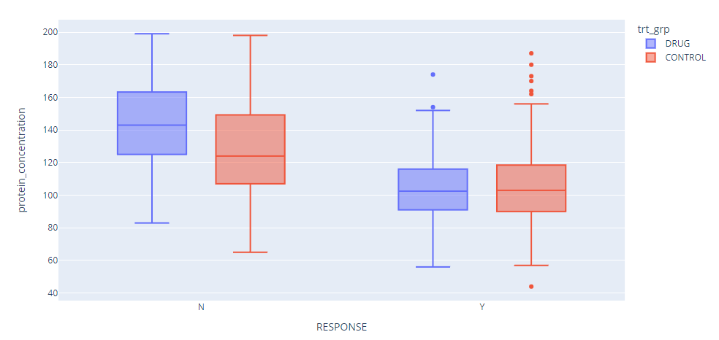
Visualizing
Notes:
Our product areas | GSK

Slide 8
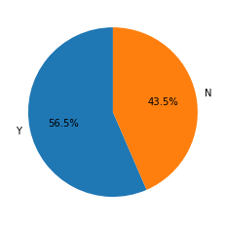
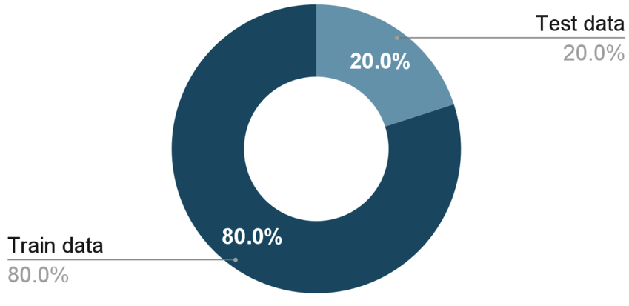
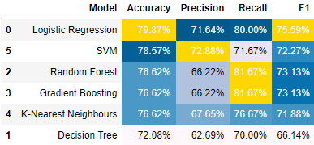
Modelling
Ratio of Outcome Variable
Train / Test Split
ML Results
Notes:
Our product areas | GSK

Slide 9
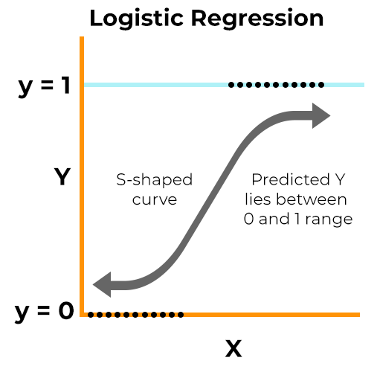
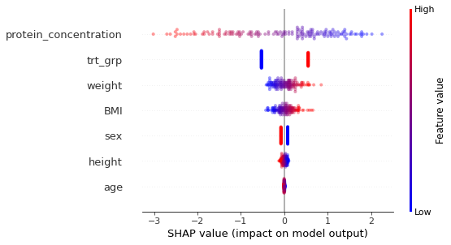
Logistic Regression & Feature Importance
The Shapley value of a given feature is calculated as
the average marginal contribution to the overall model score.

Slide 10
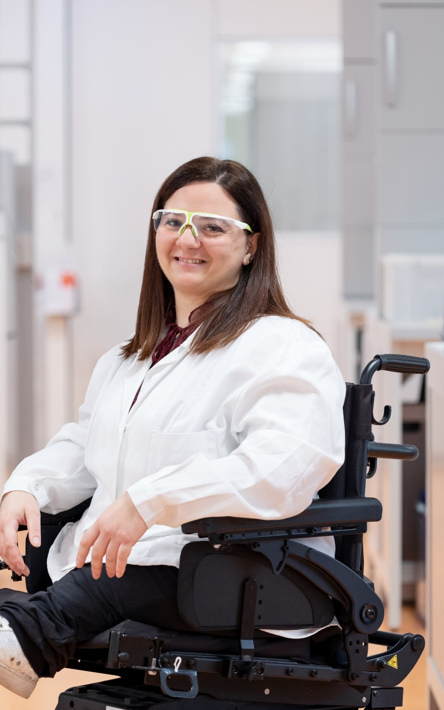
Answers and Conclusions
Do patients that take the GSK drug respond more to treatment compared to those in the control group?
Yes, the group with a positive response goes up from 32.2% to 54.8%.
Can the age, weight or protein concentration of patients predict whether they will respond better to treatment or not?
Yes, protein concentration is the most relevant feature, followed by treatment group, weight, BMI, sex, height and age.
The Machine Learning model achieved 76% F1 score (better metric due to imbalance than accuracy). It can be improved with further patient data (omics, blood tests, ethnicity, etc.)
The model can be incorporated into a web app for doctors so they can quickly and easily access the information they need to make informed decisions about patient care. This can improve patient outcomes.

Slide 11
Thank you!
Marcos Fabietti
ignaf93@gmail.com

